Slide 1
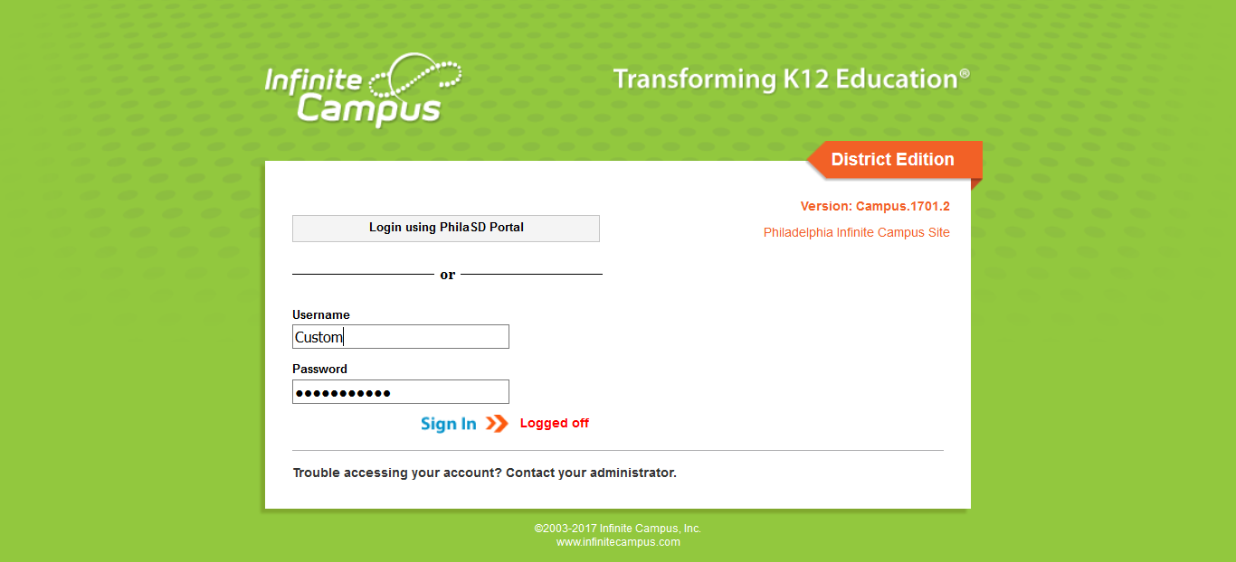
Period Attendance and Grade Book for High School Teachers
August 2017

Slide 2
Welcome and Introductions
Infinite Campus is now the School District of Philadelphia’s Student Information System (SIS).
Welcome
My Name is…
Housekeeping
Ground rules
Notes:
Summary:
A welcome to the Infinite Campus (IC) SIS Coach August training and statement of goal setting for the group. Participants are here to learn the new Grade Book and how to take attendance in IC. Please go slow and make sure all participants are clear on Campus Instruction. Teachers will no longer be taking attendance on paper. Teachers need to know how to take attendance on the first day of school.
The system has been updated and it looks different from what they saw in May.

Slide 3
Agenda
Navigation
Campus Instruction
Campus Tools
Account Settings
Roster
Attendance
Student Groups
Grade Book
Planner
Reports
Notes:
Go through the agenda.

Slide 4
Goals
By the end of today’s session, you will receive hands-on practice in:
Adjust Account Settings
View Roster and Print Report
Attendance (View Video)
Excuse Attendance (View Video)
Create Student Groups
Use features in Grade Book to:
Update Preferences
Create a Category
Create an Assignment
Grade an Assignment
Create Section Groups
Planner
Print Reports
Notes:
Go through the goals. These goals are also listed on the participants Agenda. They will be able to check off as you go.

Slide 5
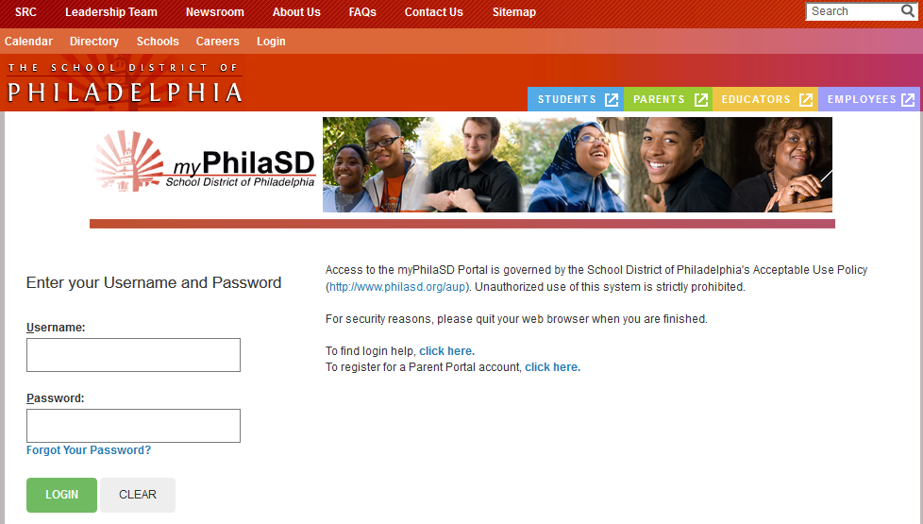
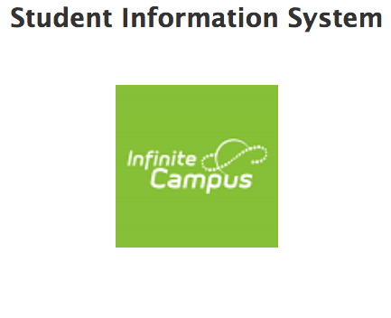
Log In to Infinite Campus
Log into the District’s Employee Portal (www.philasd.org/login) using your District Username and Password.
Notes:
Participants will log into the District’s Employee Portal (www.philasd.org/login) using their District User Name and Password. Once logged in, they will have the option of connecting to Infinite Campus by clicking on the Infinite Campus application tile.

Slide 6
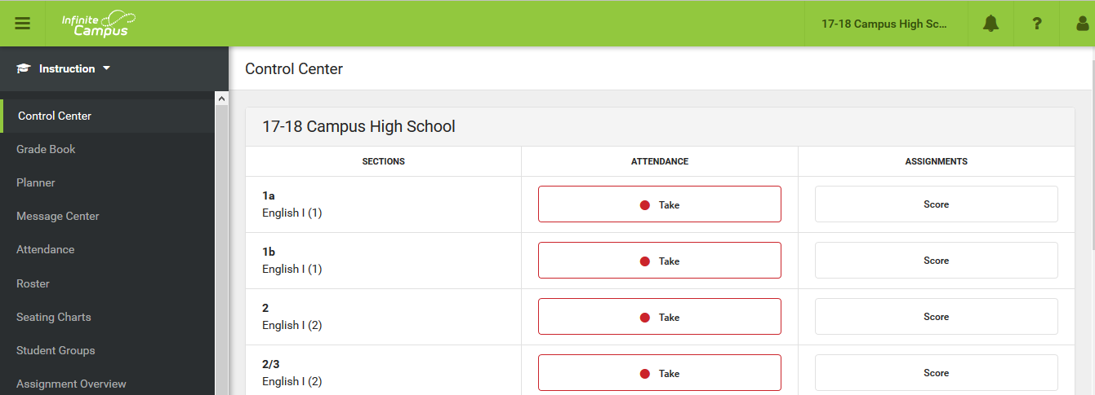
Infinite Campus – Campus Instruction
Top Green Bar
Tools
Work Area
Notes:
There are three Applications in Infinite Campus: Campus Instruction, Campus Tools, and Campus Community.
Teachers will mainly be working in Campus Instruction, while Secretaries would only be working in Campus Tools. Campus Community offers more information on Infinite Campus as a system. It is not Philadelphia specific but a great resource to learn more about the system. You will learn more throughout training on how to access the three applications. Coaches should instruct their teachers on how to create an account.
Once logged in, go over the layout of the site.
Control Center displays in the center work area. Here is where teachers will be able to take Attendance and score assignments.
Top Green Bar: Navigation bar
Calendar Display - to change, you need to click on the school name (a music teacher at multiple schools)
Notifications Icon – currently nothing will be in there for teachers
Question Mark – Help for anything you are working on.
Person Icon – to update your account settings and to log out.
Log Off is 60 minutes
Left side –Tools (tool rights driven system)
App Switcher – You start on Campus Instruction and have the option of switching to Campus Tools or Campus Community.
Middle is work area (Control Center is always the default “home” screen).

Slide 7
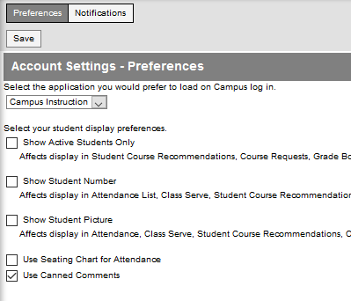
Navigation: Account Settings
Notes:
Account Settings – where you can set up how you want to see things in Campus Instruction.
First drop down – Set Campus Instruction as default if it’s not done in your live site
Active Students Only – this option will hide dropped students from Grade Book and Student Groups. We recommend that you don’t check.
We recommend you do check all below except Use Seating Chart for Attendance. Seating charts won’t be set up yet so it can be confusing.
Show Student Number - this option will display the student number on Attendance, Roster, Student Groups, and Post Grades.
Show Student Picture – This option will display the student picture on Attendance, Grade Book, Roster, Seating Charts, etc.
*Use Seating Chart for Attendance – this option will display the seating chart on the Attendance screen. Note: Trainer should demonstrate what it looks like if they checked the box vs. not checking the box.
Use Canned Comments – must be checked in order to use the SDP comments
Click SAVE

Slide 8
Navigation: Account Settings
Notes:
Activity 1: Account Settings (Stepper Page # 1)
Have the participants walk through the account settings activity.
Do not check off Use seating charts (they will get an error when they get to attendance)

Slide 9
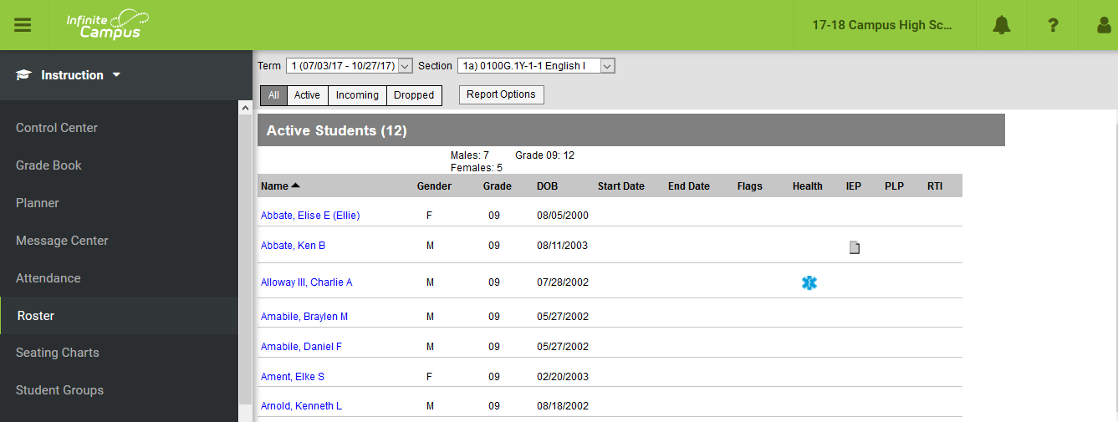
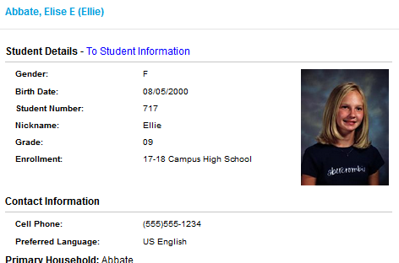
Navigation: Roster
Notes:
Please review this with the group.
Roster
This is where you go to see all of your students. Can see incoming students (show in green for 10 days) as well as dropped students, if you did not check Active students only in Account Setting.
Demonstrate hover text over Flags and Health Conditions. Click on Health Conditions for further information.
Demonstrate clicking on the student name to show Student’s Contact information. Click on To Student Information and it will take you to Campus Tools.
Use this as an opportunity to show Campus Tools – What tabs teachers have access to (Summary, Schedule, Attendance, Grades) and how to use the App switcher to get back to Campus instruction.
Note: Discuss tabs and navigation. Search > Last name, First name.

Slide 10
Navigation: Roster
Notes:
Activity 2: (stepper page # 2-5)
Do you have any students with a Flag/Health Condition? What is it for?
Look for a student’s emergency contact

Slide 11
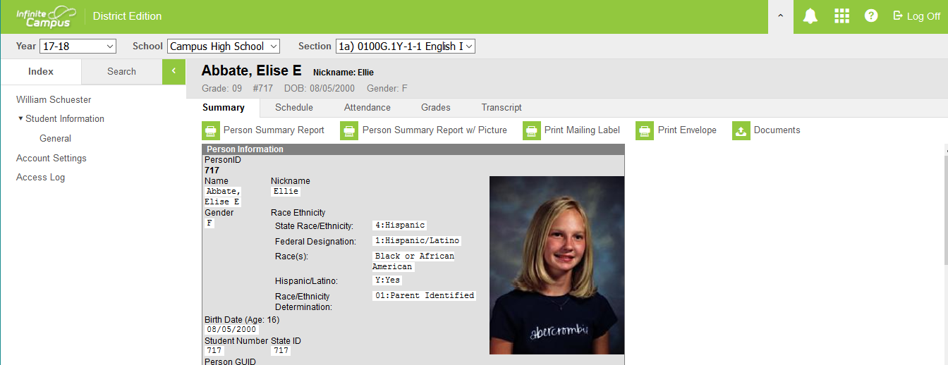
Infinite Campus - Campus Tools
Legend
Module
Tool
Tabs
App Switcher
Notes:
Campus Tools is used by Secretaries to input information about each student and their family. Teachers will only have access to a few tabs in Campus Tools.
Student Information > General is information specific to your students.
Summary Tab will show the household information and emergency contact information
Schedule Tab will show your students classes that they are enrolled in.
Attendance Tab will show Attendance events of your student
Grades Tab will show your students grades.
Modules - different sections within Campus Tools. Everyone has different Modules based on jobs and responsibilities. This is a Tool Rights driven system.
Tool - a section of a Module
Tab - How to change pages of a Tool in the Work Area

Slide 12
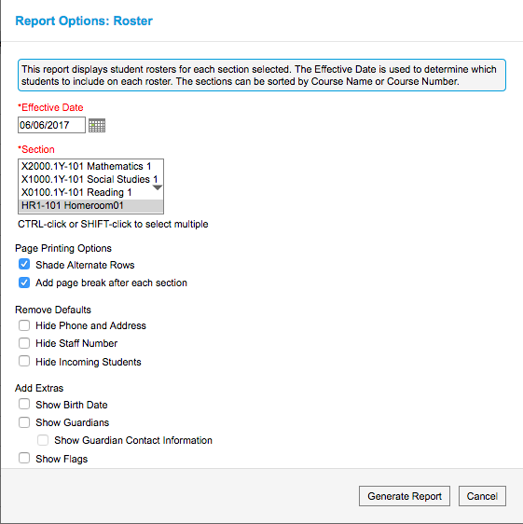
Navigation: Roster
Notes:
Activity 2: Print Roster (Stepper Page # 2-5)
“Print” your class Roster

Slide 13
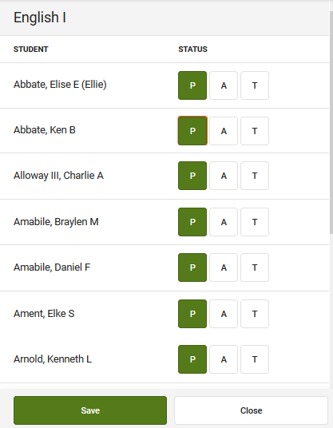
Navigation: Attendance
Notes:
HS teachers take attendance by period. HS will take classroom attendance for each period they teach. Students will still swipe in with ScholarChip for Building Attendance.
ScholarChip is used for building attendance and for Security purposes (who’s in the building). ScholarChip and Infinite Campus will sync up each period.
Note: You will show a video because it is not an attendance taking day.
Once logged in, the middle work area shows you that you need to take Attendance. Attendance events display in the work area on the Control Center.
Click on Take – box appears for the period you are taking attendance
Once marked Absent or Tardy, you have the ability to enter a comment. This is part of their attendance record – only write appropriate comments.
Click SAVE
You can only take CURRENT DAY attendance (Cannot go backwards/forwards in time)
Even if ALL students are Present, a teacher will need to go in and click SAVE
You can go back if you made a mistake or if someone came in late.
Attendance Tool:
If you choose to take Attendance using a Seating Chart, you must click on the Attendance Tool for the Seating Chart to show.

Slide 14
Navigation: Attendance
Notes:
Activity 3: Attendance (Stepper Page # 6-7)
Watch video
Please show participants the video, make sure you expand the video to ensure everyone can see. Make sure you have speakers to allow the audience to hear.

Slide 15
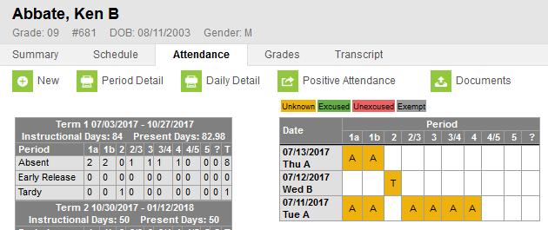
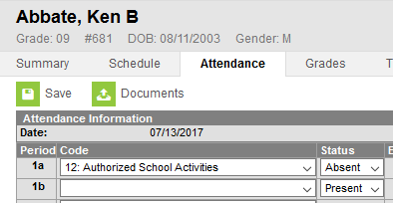
Navigation: Excuse Period Attendance
Notes:
Teacher’s will be able to Excuse Period Attendance. The Procedure depends on your school. For some, the Secretaries will do. For others, the teachers(Homeroom/Advisories) excuse attendance. Ask your principal who should be doing this. This will be done on the Campus Tools side, on the Attendance Tab.
Note: You will show a video because you won’t be able to do this live in the Live site.
For extracurricular activities, such as sports or clubs, use code 12 -Authorized School Activities. This will show that a student was absent from your class but it was excused.

Slide 16
Navigation: Excuse Period Attendance
Notes:
Activity 4: Excuse Period Attendance (Stepper page # 8-9)
Watch video
Please show participants the video, make sure you expand the video to ensure everyone can see. Make sure you have speakers to allow the audience to hear.

Slide 17
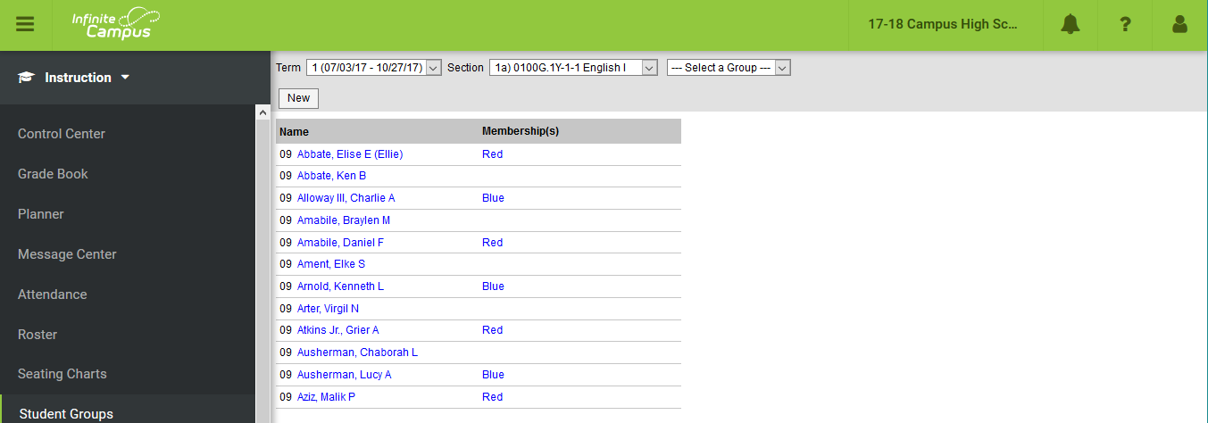
Navigation: Student Groups
Notes:
Student Groups provide the ability to differentiate assignments for groups of students. Once created, teachers can select which groups to assign work to and can filter the grade book to see the progress of a group.
Groups can be created for low, medium, high, ESOL, or Special Ed. Be aware that they will show in the portal so name them appropriately.
Students can be in multiple groups.
Student Groups functionality is for the Grade Book
Note: Special Ed and ESOL teachers should have access to the Grade Book of the teacher they support. If they don’t, the Principal needs to add that connection. Please talk to your principal.
This feature may not apply to all of your staff. You can group your teachers accordingly when planning turn around training.

Slide 18
Navigation: Student Groups
Notes:
Activity 5: (Stepper page # 10)
Create groups to differentiate assignments in gradebook

Slide 19
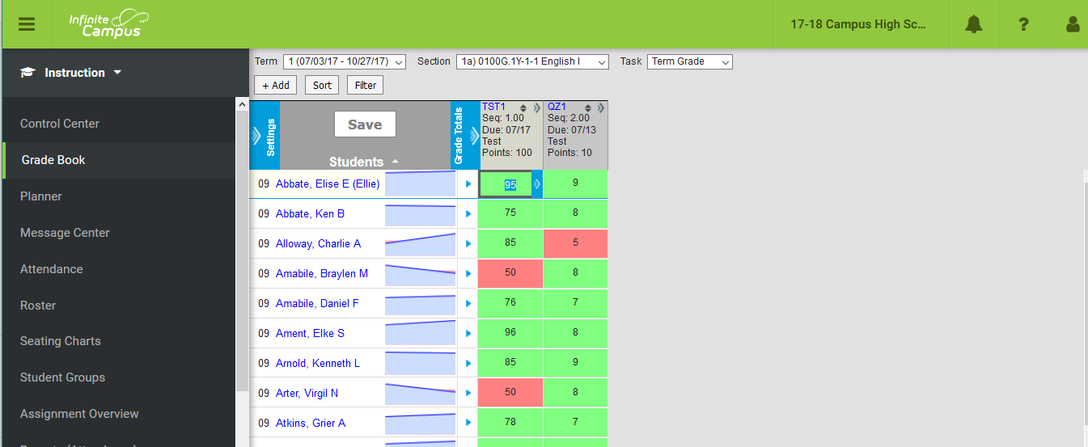
Navigation: Grade Book
Notes:
Grade Book tools allow teachers to view assignment scores for multiple assignments. Teachers can enter grades for individual students or in batch.
Explain the layout (Add some assignments to your Grade Book so you can show teachers what it will look like)
Broken down by term, section, task
Students on the left (toggle outline for more space, 3 lines at top left)
Posted area (only open when the posting window is open), in progress, categories, assignments
Chevrons to expending and collapsing, clicking on blue links to access information (student info, assignment, categories)
Hover capabilities
Color Coding
Grade Book Reference Guide handout provides the participants information about each section of the Grade Book.
Go through Settings : Preferences and Categories
Preferences (no need to save)
Display Sparkline Graph – displays next to each student’s name
Pass/Fail Coloring for Grades – display color for In-Progress Grades and Posted Grades
Pass/Fail Coloring for Scores – display color for individual assignment scores
Save Alert – notification after clicking <Save> button *This is annoying and most don’t check it.
Assignments for Page – can set the number of assignments that display
Categories (set by SDP)
Discuss weighting. Read only. You can not change.
Create Assignments and Grade Assignments
Click the +Add button (easiest place to create an assignment)
MUST do the things in Red
Explain each button at the section placement level:
Which section(s) will use this assignment
Campus Portal – this assignment will display on the portal
Assigned/Due Date – both red. Due date determines which Grade Book view assignment is used in
Sequence – can be used to order assignments (see above for explanation)
Student groups – if set up already, assignments can be created for a particular group. The rest of the students will be exempt
Select the Category
Select the Grading Task
Choose Points
Define Total Points value
If needed, change the multiplier (typically left a 1)
Save
For Students and For Teacher – For Students will show on portal. For Teacher is just for you.
Explain/show the Save options at the bottom (copy, New, Score, etc)
Scoring Process
Score one assignment and discuss how color coding automatically appears and in-progress grade automatically calculates (Live time).
Can use arrow keys
Show how to score en masse - Fill Scores/Comments
How to sort by scores
How to edit the assignment by clicking the blue link.
Explain the different communication tools (T,M,L,I,CH,X,D) and the Student Submission area.
Explain the Comments text box (Portal view, so be careful what you write)
Section Groups (in Settings) Advise that Coaches can skip is this doesn’t apply to their teachers.
Click Add
Name it
Choose the sections you want to group
Choose a different color for each section
Give a Seq, if you choose
Section Groups will show in Section drop down
Note: Section Groups may not apply to all of your staff. You can group your staff accordingly for turn around training. This would be beneficial to Specialist teachers with multiple classes of the same grade level, a teacher who teaches 3 sections of English I.

Slide 20
Navigation: Grade Book
Notes:
Activity 6: Settings (Stepper page #11 - 14)
Settings > Preference and Categories
Activity 7: Create an Assignment (Stepper page # 15-16)
Add an Assignment, at least three
Activity 8: Grade the Assignment (Stepper page #17-18)
Grade the Assignment
Activity 9: Create a Section Group (Stepper page #19-20)
Create a Section Group

Slide 21
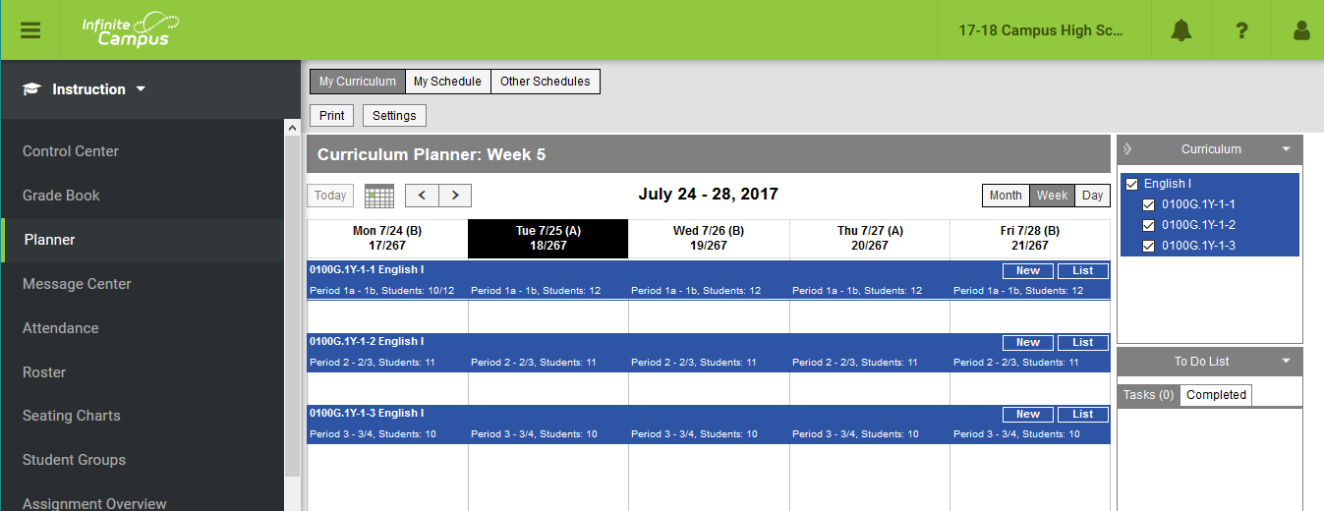
Navigation: Planner
Notes:
The Planner displays student attendance events as well as all your assignments. That is all it does, it is not used as a true Planner.
Make sure to be on the Week view (month view doesn’t show information).
Visual way to manage assignments
Click on a section to manage assignments
Click on the student count under the section to get attendance information from a previous date
Tells the day of the year (ie. 100th day of school), rotation day

Slide 22
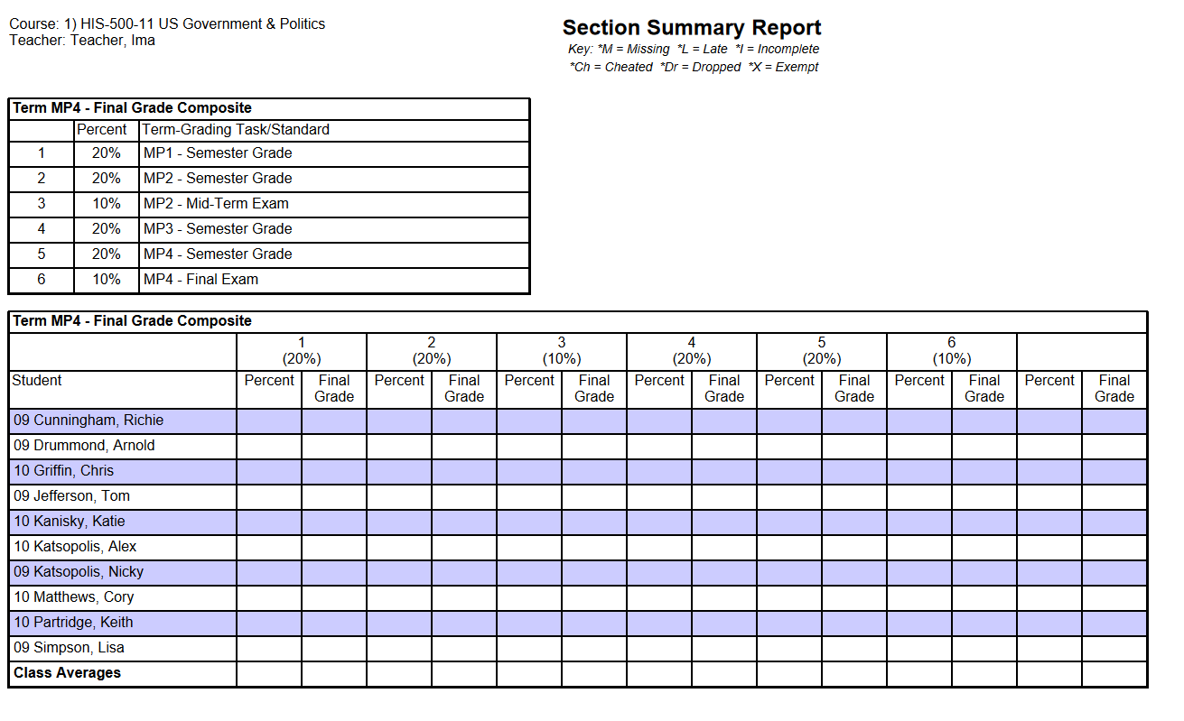
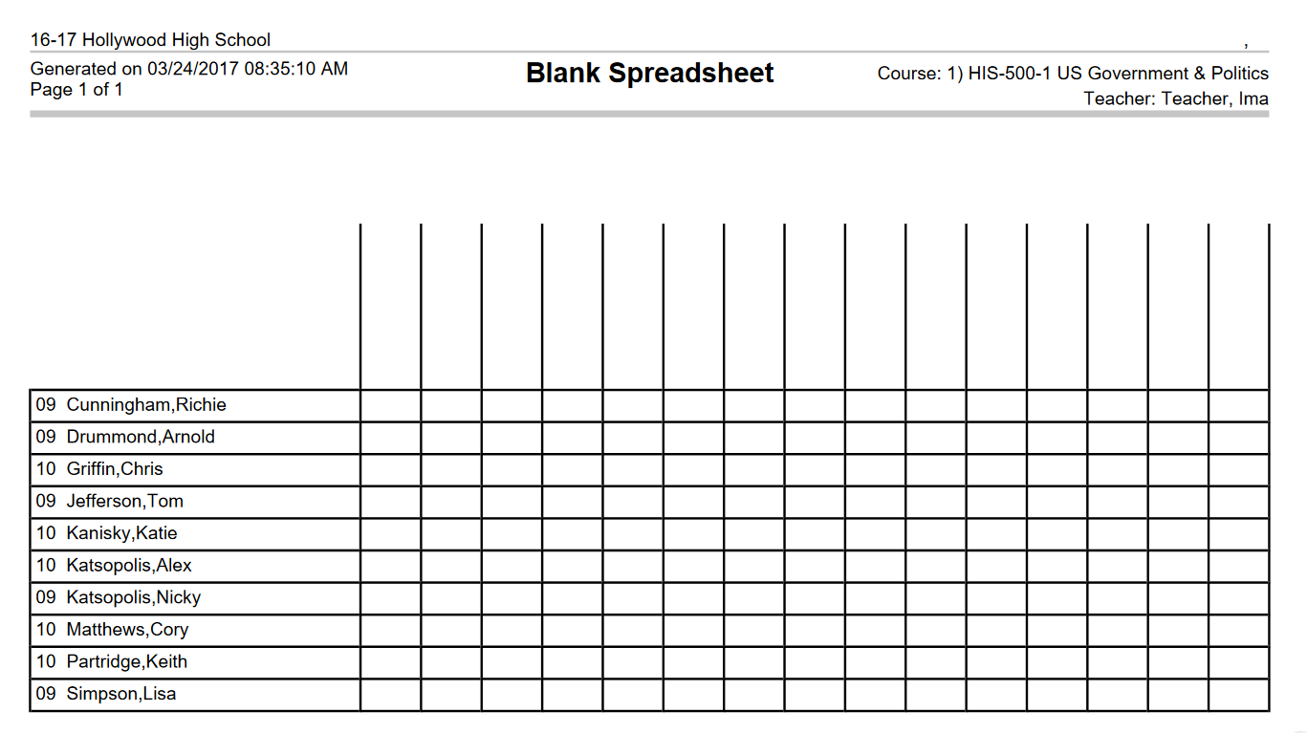
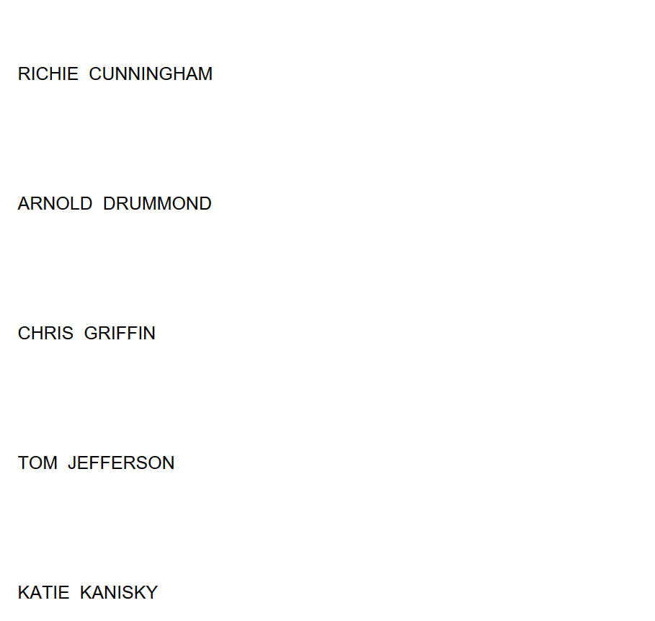
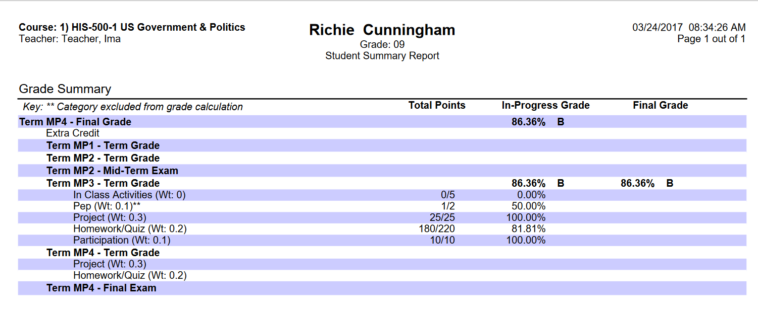
Navigation: Reports
Notes:
Only run one/two reports. A list of reports and their purpose will be posted on the sishelp website.
Good Reports to show:
Grade Book – Section Summary (snapshot of Grade Book)
Grade Book – Student Summary (snapshot of student) Using for Interims
Roster – Blank Spreadsheet (teachers love this)
Roster – Labels (show how to make folder labels instead of mailing)

Slide 23
Navigation: Reports
Notes:
Activity 10:
Generate a few reports

Slide 24
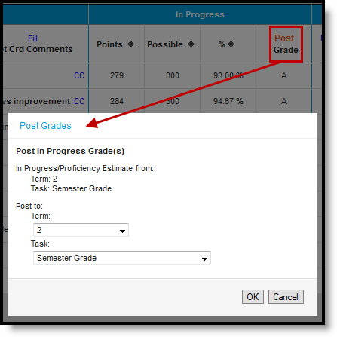
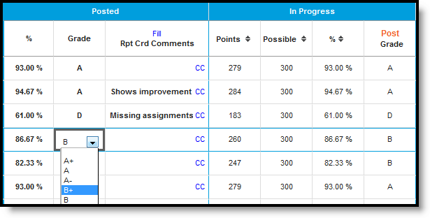
Navigation: Post Grades
Notes:
Note to the trainer: Teachers will only be able to Post grades when the Posting window is open. This is a quick overview. Posting = Verify
Demo only. They will see it in detail in October.
When the Grading Window is open, clck the <POST> button.
A pop-up menu will appear. Select the Grading Task to which the ‘In-Progress’ grade should post. By default the current task will populate.
Click <OK>. Grades will be posted upon SAVE.
Click the CC (canned comments) link to open the comments window. Click <SAVE> when finished.
Repeat for each Grading Task.
To Edit Posted Grades:
Click on the calculated grade listed in the Percent field. Changes can be made when the grading window is open.
Type in the new grade and press the <Enter> key. The grade will change in the % column.
Make sure to change the % and not just the grade. The % goes to term/final grade.

Slide 25
Wrap – Up
Post-Session Survey
Questions
SIS website for support:
www.sishelp.philasd.org

